Slide 1
Drinking And Driving
Migdalia Rodriguez

Slide 2
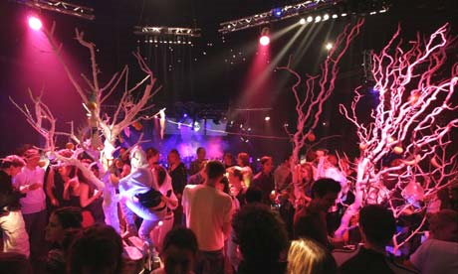


Slide 3
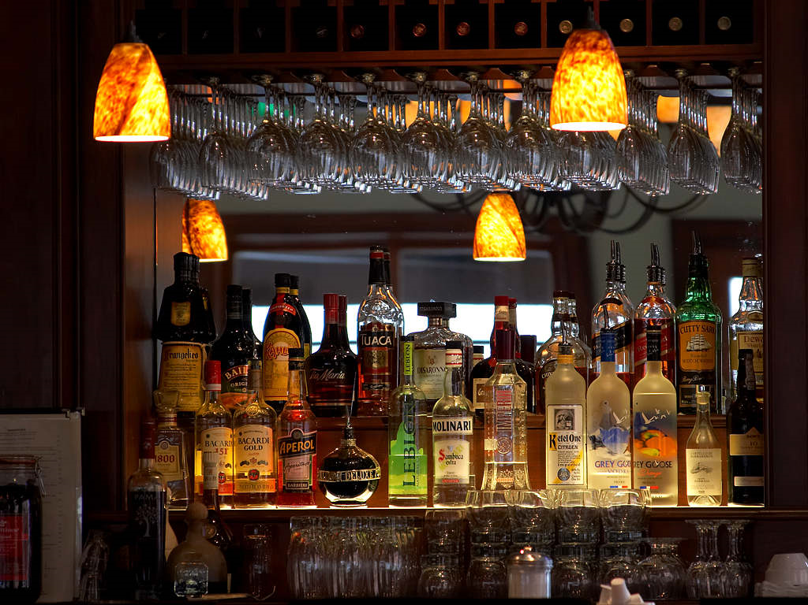

Slide 4
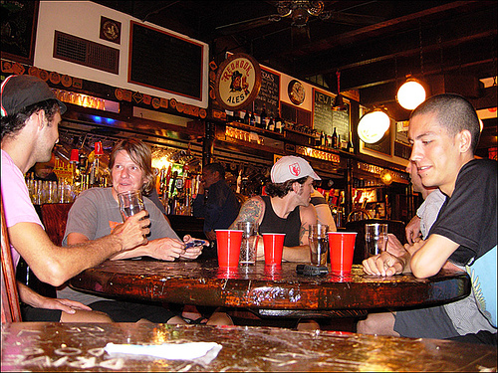

Slide 5
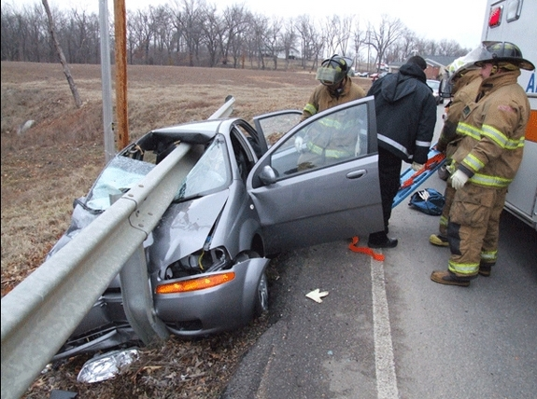

Slide 6
THE END
THANK YOU

