Slide 1
THE POWER OF WORDS
BY WILLIAM MURRAY

Slide 2
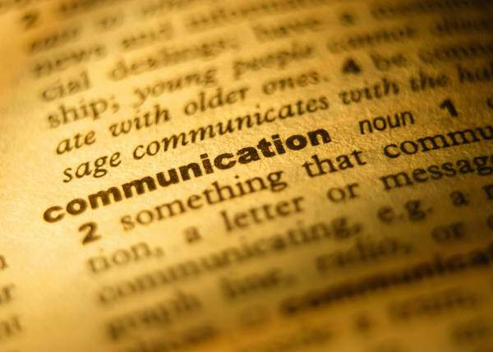
Language and words communicate wisdom

Slide 3
On December 16, 2003 I was invited to the home of Eve Ensler, an American playwright, performer, feminist and activist, best known for her play The Vagina Monologues. Together with my cousin, and two of Eve’s guests, we closely watched the premiere of What I Want my Words To Do To You, a film focused on a writing workshop inside Bedford Hills Correctional Facility for Women led by Eve Ensler.

Slide 4
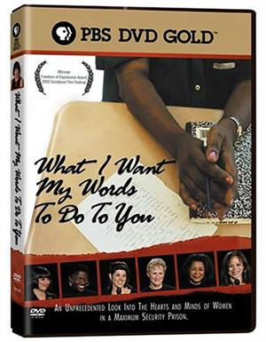
The film documented both the wrenching personal journeys undertaken by the inmates to find the words that tell their own stories, and the power of those words to move the outside world

Slide 5
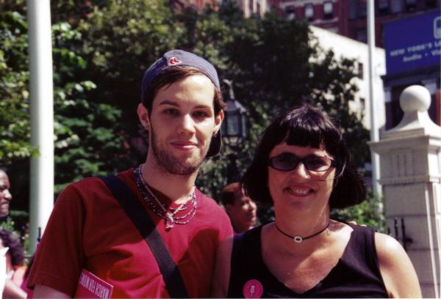
Me & Eve Ensler
New York March for Women's Lives, August 2004

Slide 6
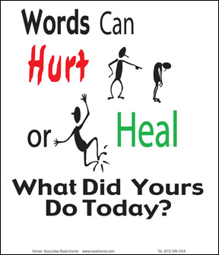
I have always been compelled to learn more about why people do not always use the same words to describe their perception of a circumstance, in the same way as all others. As a self-identified activistic poet, I’ve always sought to define the words with which we use to educate and address individuals, so I can be a spreader of art and information in my own life. I was further inspired by Eve Ensler’s social commentary and fight for justice.

Slide 7
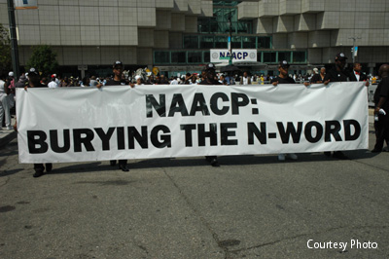
I believe when we absorb mentally, words like “nigga,” a word which evolved from the derogative term "nigger,” it has a negative effect on our psyches. Even as a clichéd expression, used liberally by people who’ve deemed it cultural appropriation, it can still be perceived as off-putting.

Slide 8
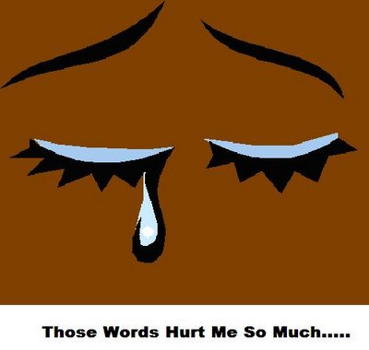
Therefore, a word with connotations you think may have changed from pejorative to acceptable, can actually still affect people unconstructively.

Slide 9
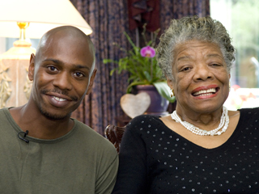
I often call people out on their ignorance, when I am in the presence of discrimination against gays, or where racial/homophobic slurs are being made. I’ve found that the best way to heighten another’s awareness around their poor word choice is to mention how we are heinously bringing people’s character into disrepute when we call them out their name. One of my favorite poet’s Maya Angelou, brought comedian Dave Chapelle to task, discussing how poetry and comedy can bridge both genders and generations during an episode of Iconoclasts, on the Sundance channel. Angelou has been very outspoken about hip-hop artists’ use of insulting language, even disagreeing with Russell Simmons’ comment that “comparing Don Imus’ language with hip hop artists’ artistic expression is misguided and inaccurate.” (*Don Imus was the shock-jock known for the Rutgers women's basketball "nappy-headed hos" controversy)

Slide 10
“It’s all the same. All vulgarity is vulgarity. If you mean to demean a person, to make her or him less than whole — anyone could say it, you could say it from a robot — it means that this person is not worthy of my concern. But at last we’re going to have a dialogue, I’m telling you. Nelly, P. Diddy, Snoop Dogg — all of those men, who are very intelligent — and I include Dave Chappelle — for the first time we are going to sit down and see how have we come so late and lonely to this place. I would ask the hip hoppers, if you wanted to say something and see how powerful you are, use Ms. Laura Bush and call her one of those “b-” words — and see how long you will live. There wouldn’t be enough rope to hang your butts. No. But black women, because we are last on the totem pole, everyone has a chance to take a chance on us. Well, not now.” –Maya Angelou

Slide 11
GLSEN and Ad Council's ad campaign from thinkb4youspeak.com

Slide 12
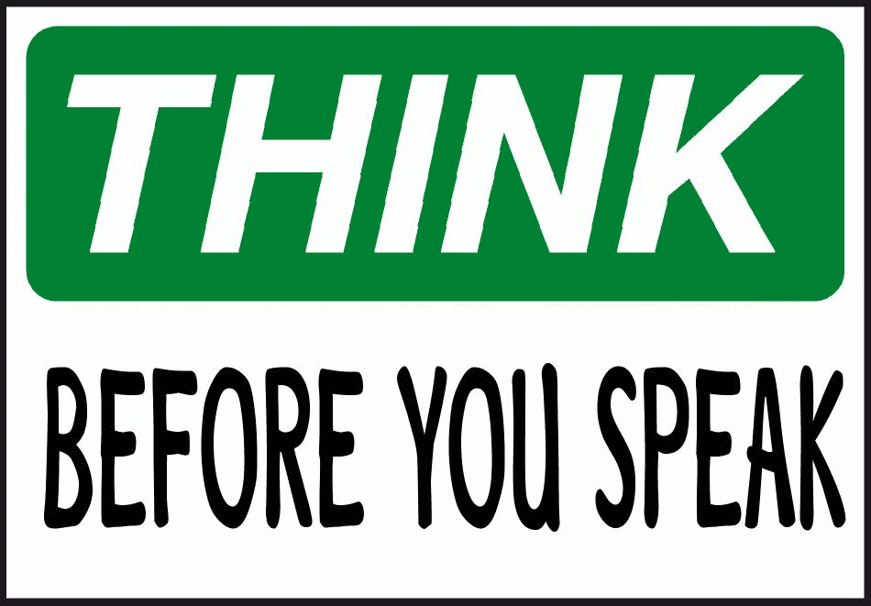
Ad Council and GLESN deems terms like "That's So Gay” as derogatory language. What you say and how you communicate can make a big difference in how people respond to you.

Slide 13
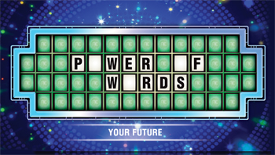
Which Will You Choose? There are buzz words, dirty words, and four letter words. There can be a play on words by twisting words. There are words to the wise. There are words of mouth, and words we figuratively eat. Famous last words. Words of one syllable. Kept words. Pictures worth a thousand words. There are words to live by and operative words. There are fighting words and magic words.

Slide 14


